Slide 1
History of Life

Slide 2
Previous discussion
Definition of LIFE.
Big-Bang Theory of formation of galaxies, solar system.
Theories
1. Theory of Special creation.
2. Theories of Spontaneous generation.
3. Modern theory explained by Miller.

Slide 3
Abiogenesis :: Origin of life from non-living matter :: Special creation theory :: Disproved by Francesco Redi, Lazzaro Spallanzani and Louis Pasteur.
Biogenesis : Live come only from other living things.
Chemical Evolution :: Oparin and Haldane theory
Miller’s experiment :: Formation of Biomolecules
Sydney Fox and co-workers :: Formation of Proteinoid (synthetic peptides).

Slide 4
Experiment of Lazzaro Spallanzani

Slide 5
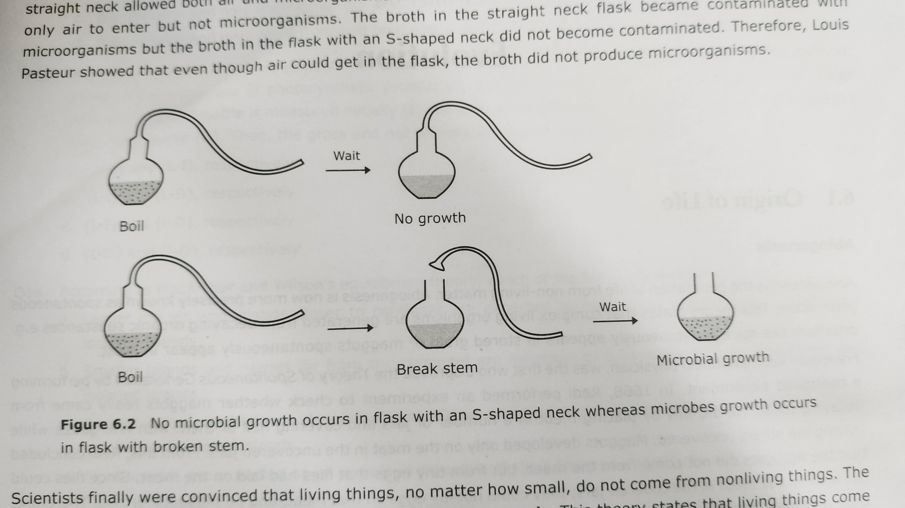
Experiment of Louis Pasteur

Slide 6
Oparin and Haldane theory :: Chemical Evolution :: Life had arisen from simpler molecules on lifeless earth
Earth

Slide 7
Oparin and Haldane theory :: Chemical Evolution
Hot Dilute Soup
Earth

Slide 8
Oparin and Haldane theory :: Chemical Evolution
First Biomolecules
Biomolecules
CH4
H2
Lightning UV rays
Protein
Polysaccharide
RNA
Simple Sugar
Amino acid
H2O
Volcanoes
NH3
CO2

Slide 9
Formation of Coacervate
Coacervate
Properties:
Able to exchange substance with the surroundings.
Can increase in size.
Selectively concentrate compounds within them.
Note:
Sydney Fox (1950): Formation of Microspheres from Proteinoids.

Slide 10
Development of Outer Membrane
Hydrophilic end
Amphipathic molecules
Hydrophobic end

Slide 11
Unit7: THEORIES OF BIOLOGICAL EVOLUTION

Slide 13
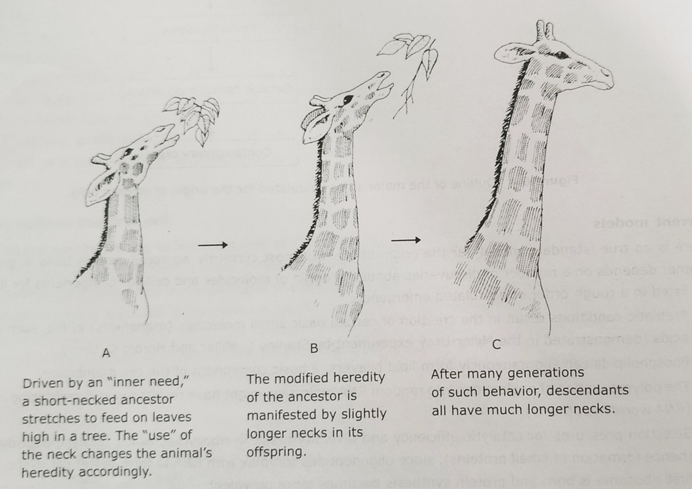

Slide 14
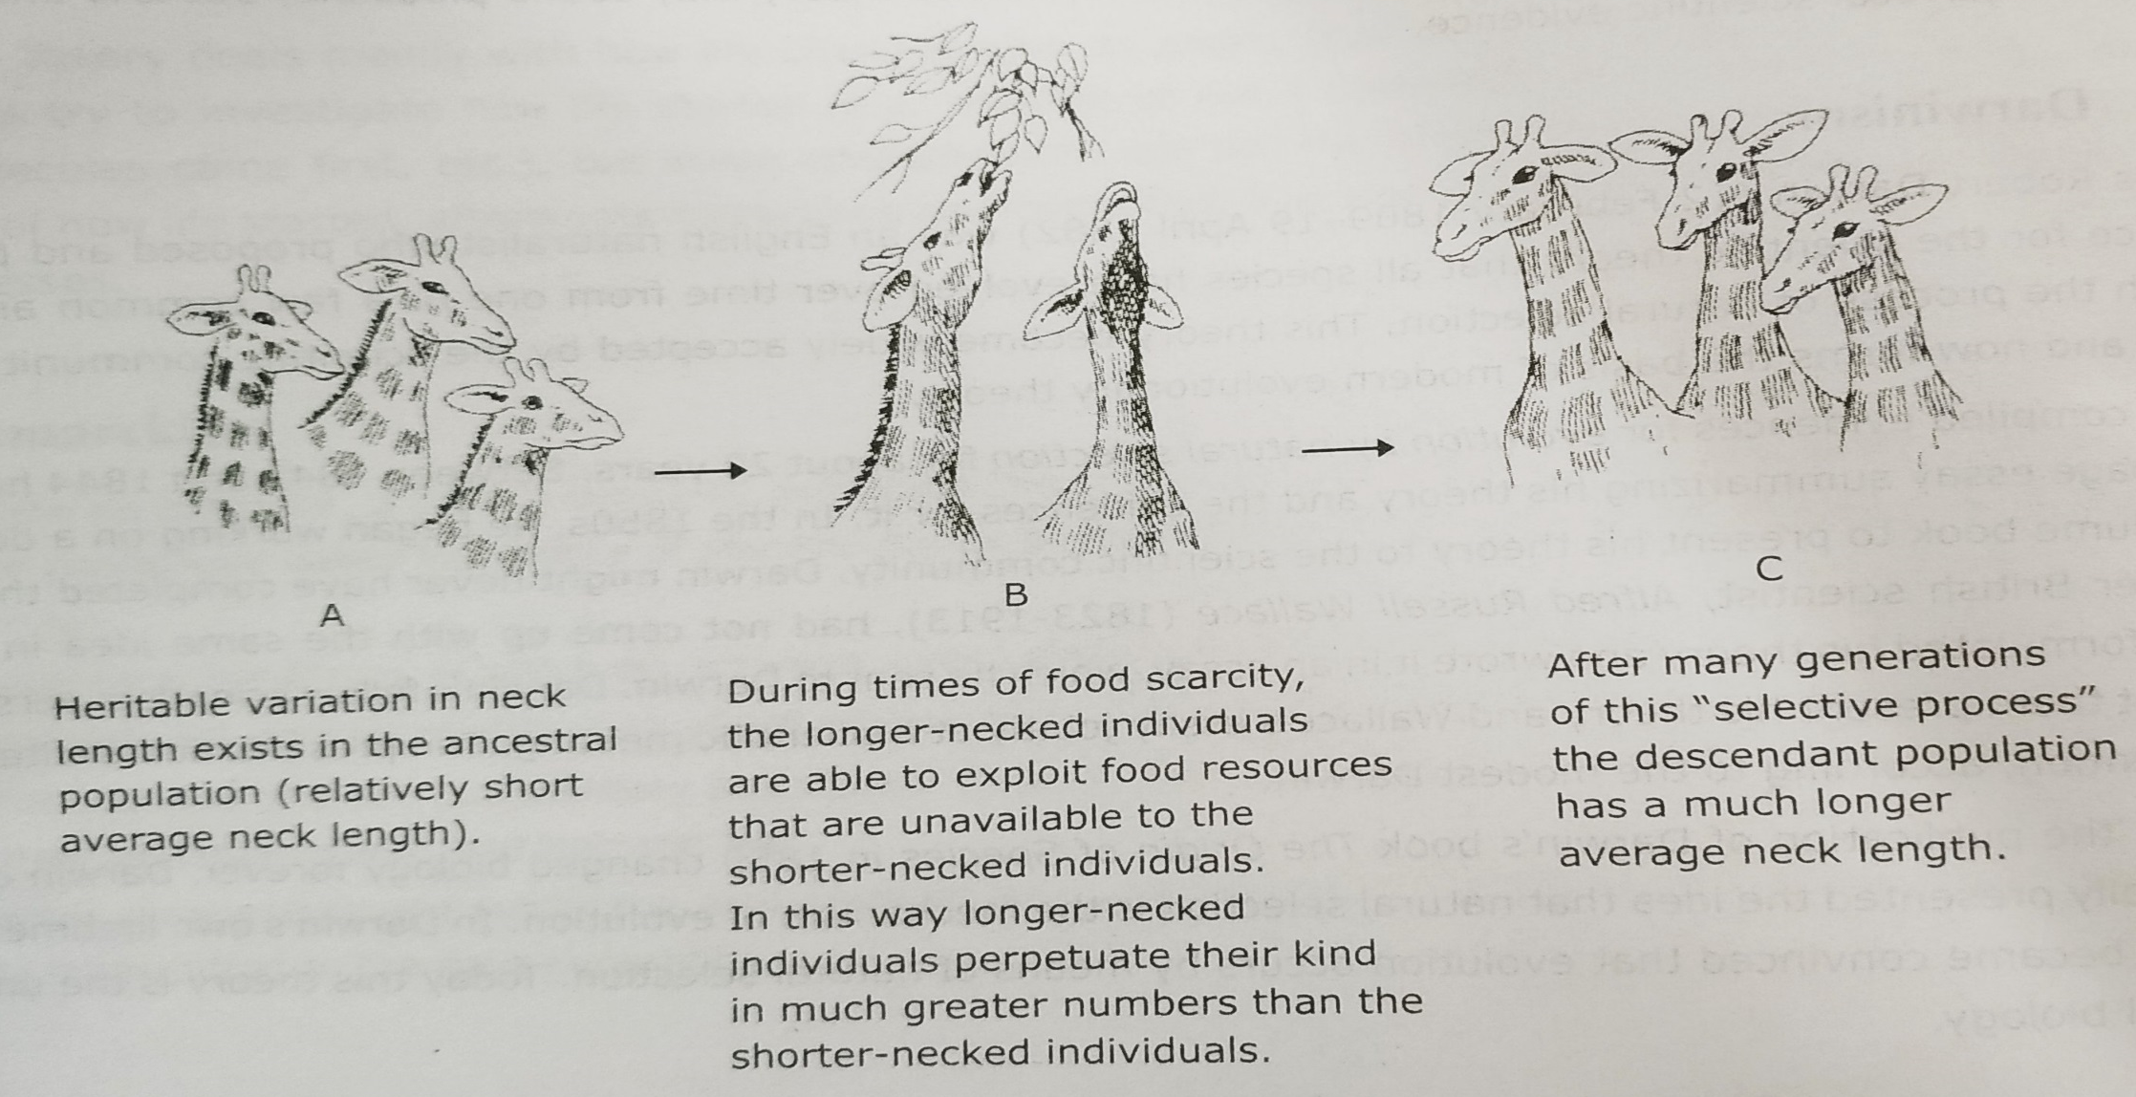
Darwinism:

Slide 15
Neo-Darwinism
Islands
Darwin’s Finches

Slide 16
